Slide 1
Code-First Approach
Lecturer: Ngo Huy Bien
Software Engineering Department
Faculty of Information Technology
VNUHCM - University of Science
Ho Chi Minh City, Vietnam
nhbien@fit.hcmus.edu.vn

Slide 2

Objectives
To use Entity Framework and Code-First Approach to develop a software application.

Slide 3

Contents

Slide 4

References
Brian L. Gorman (2020). Practical Entity Framework. Apress.

Slide 5
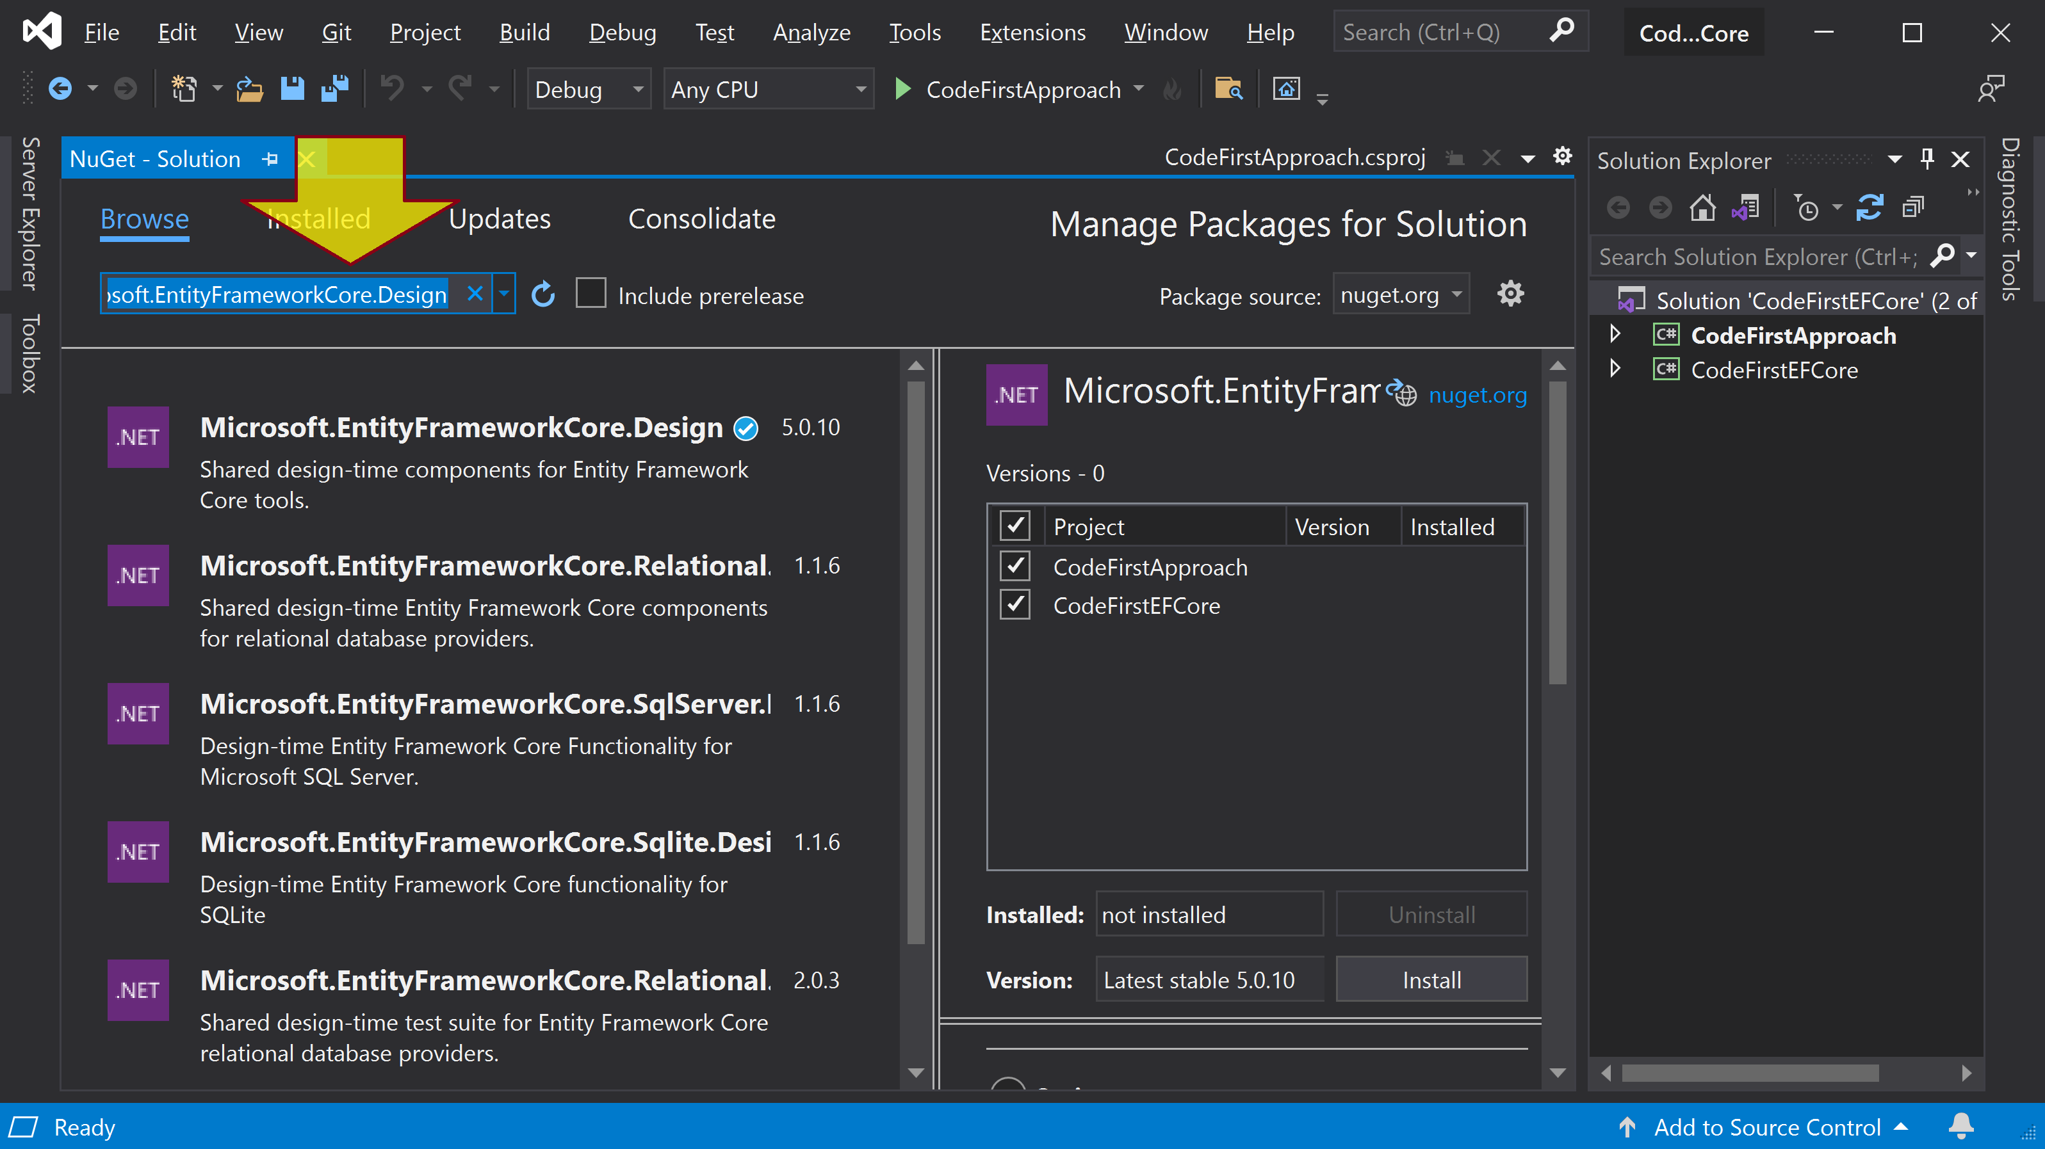
Install Microsoft.EntityFrameworkCore.Design

Slide 6
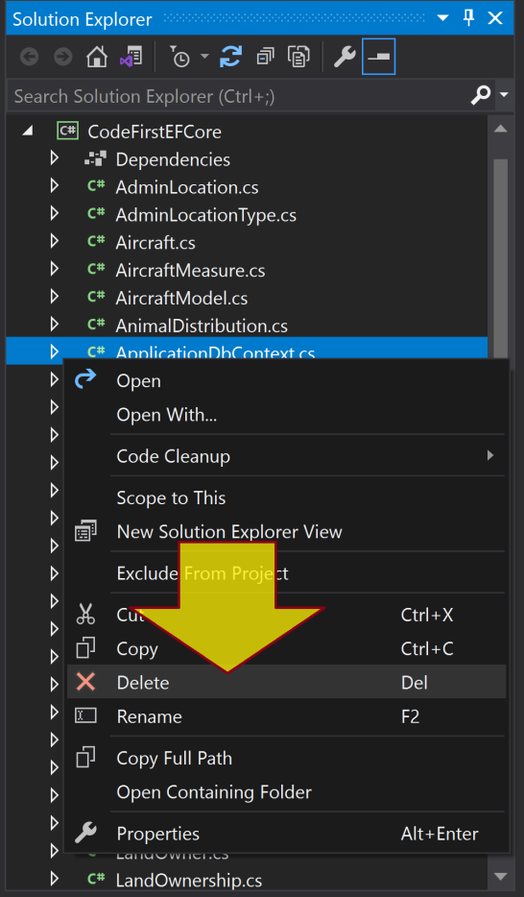
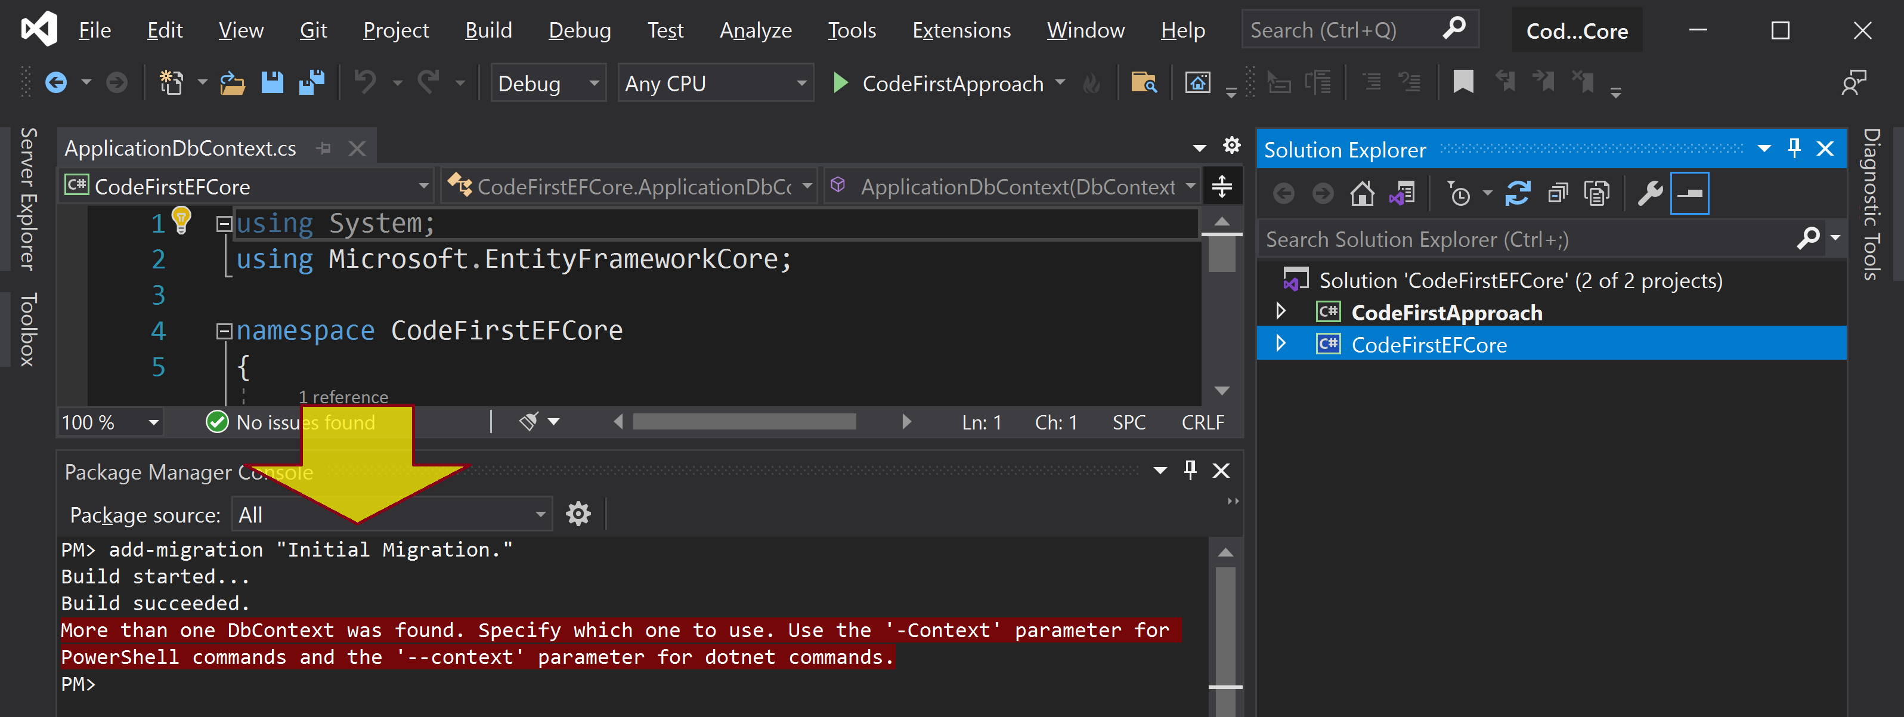
Create the Initial Migration
add-migration "Initial Migration."

Slide 7
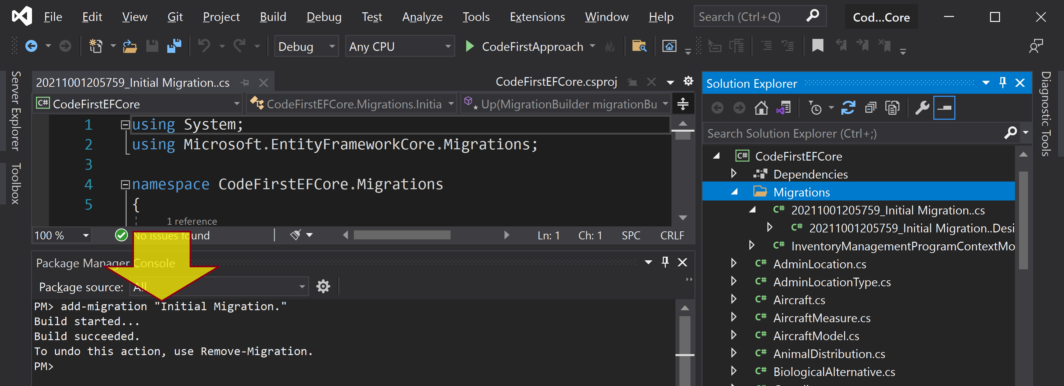
Create the Initial Migration Again
add-migration "Initial Migration."

Slide 8
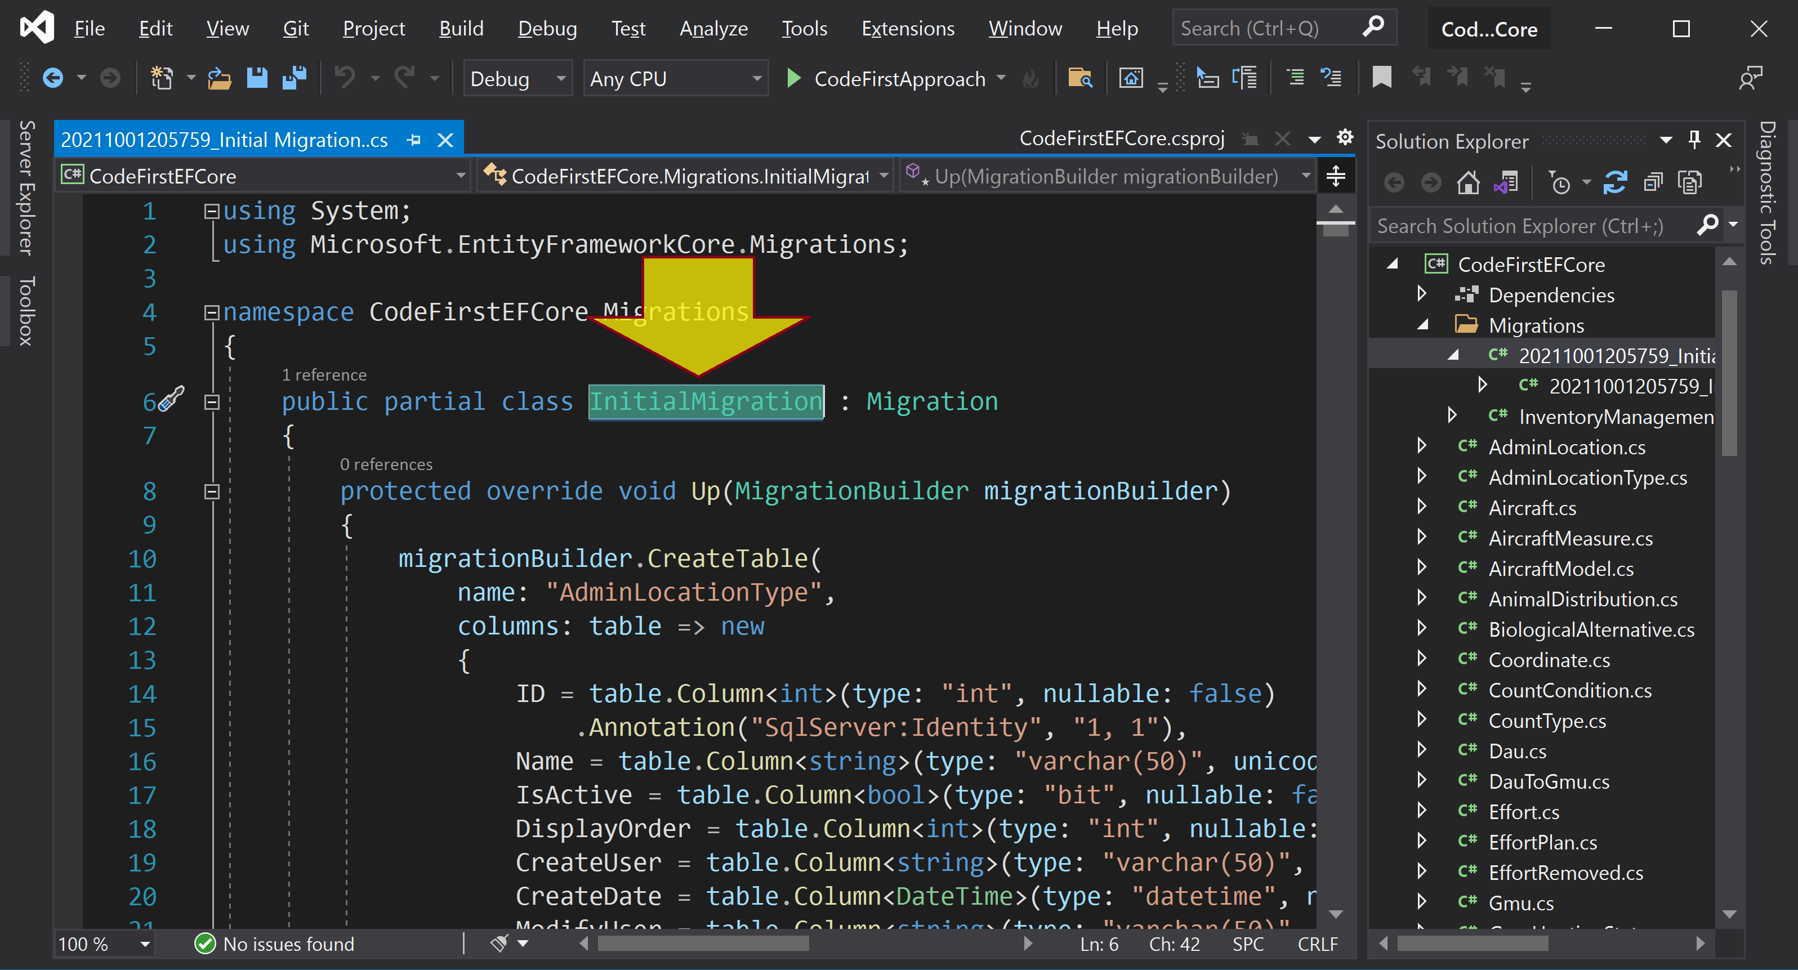
Review InitialMigration Class

Slide 9
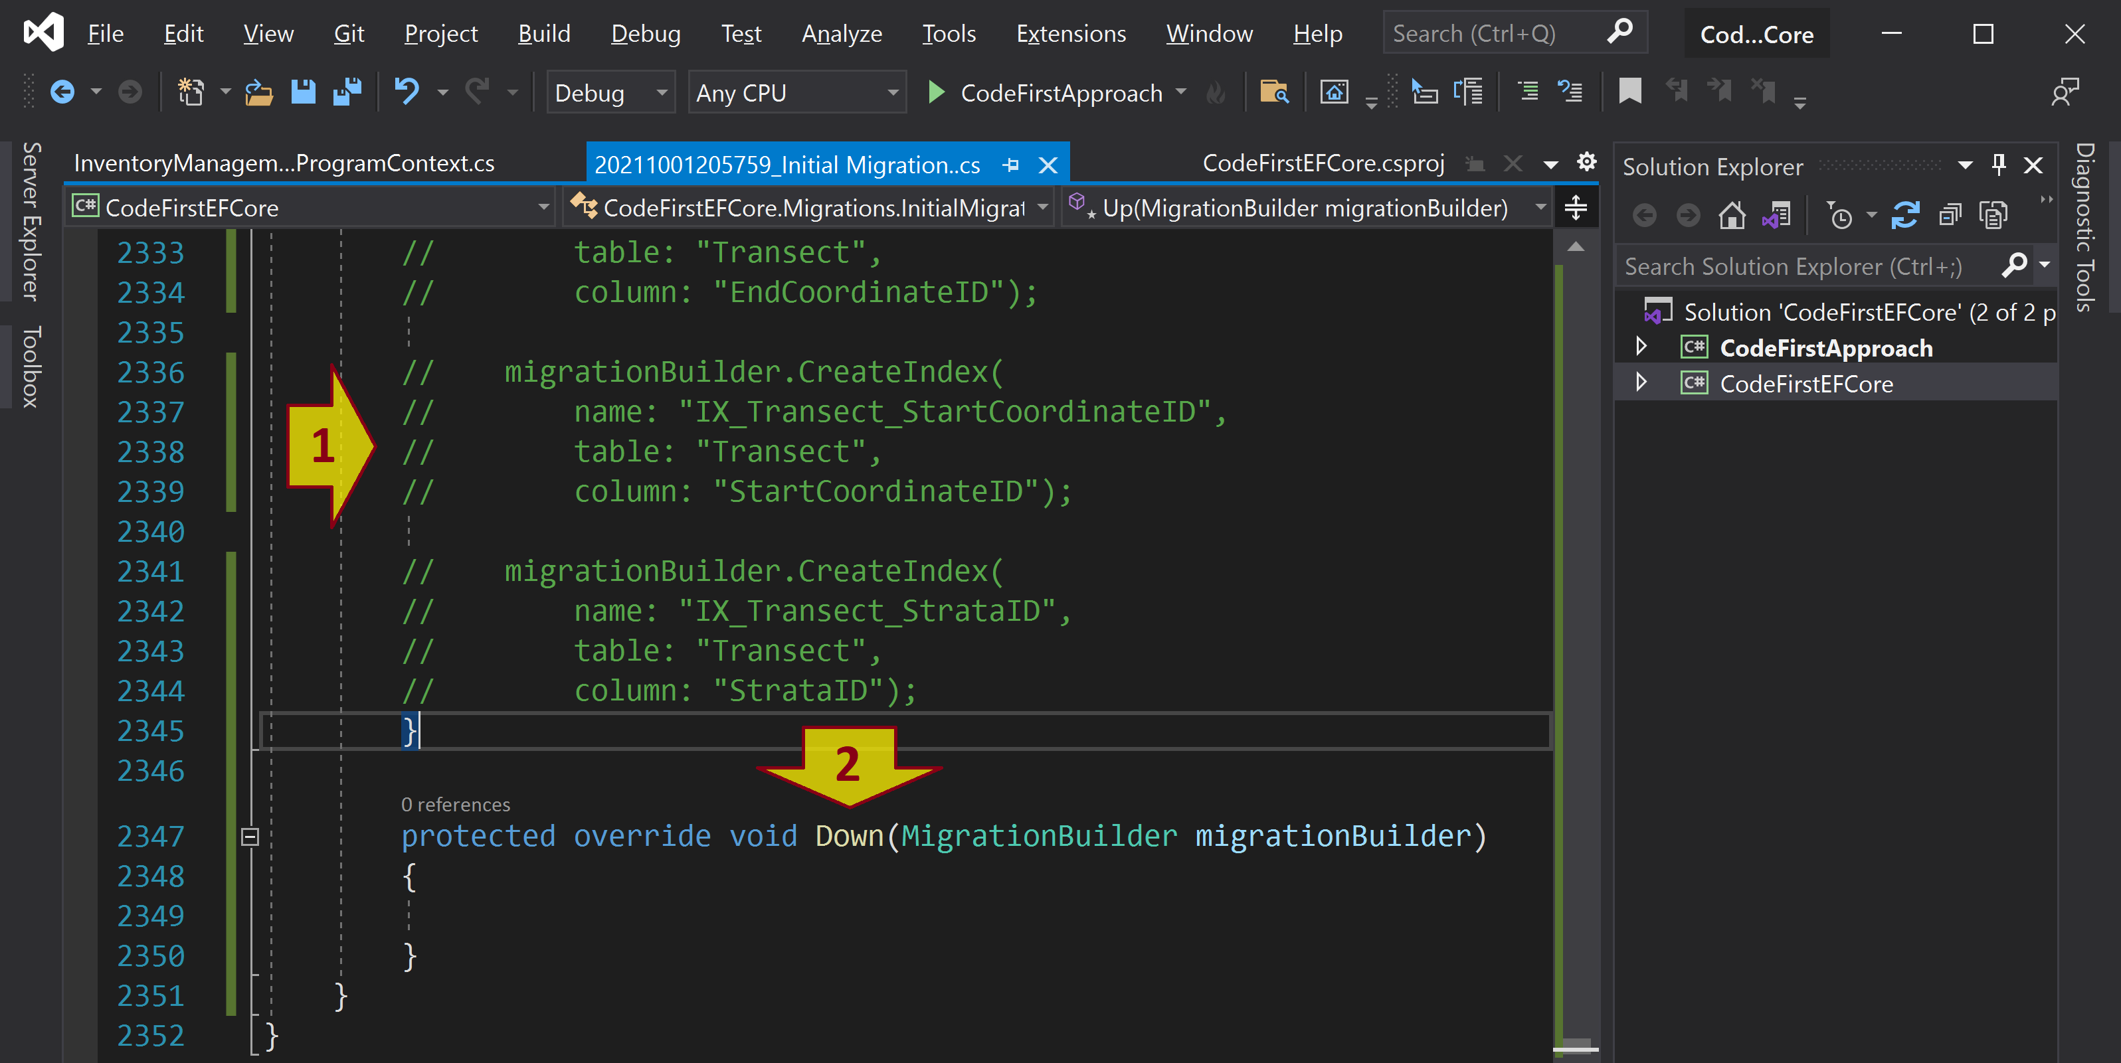
Comment out and Delete the Code
Comment out the code in the “Up” method and delete the code in the "Down" method.

Slide 10
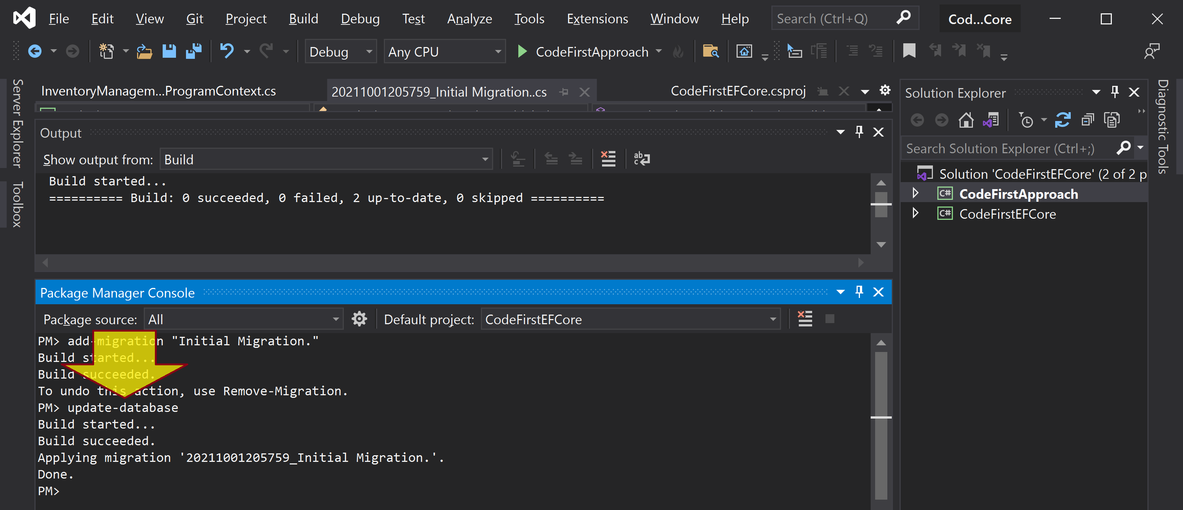
Run update-database Command
update-database

Slide 11
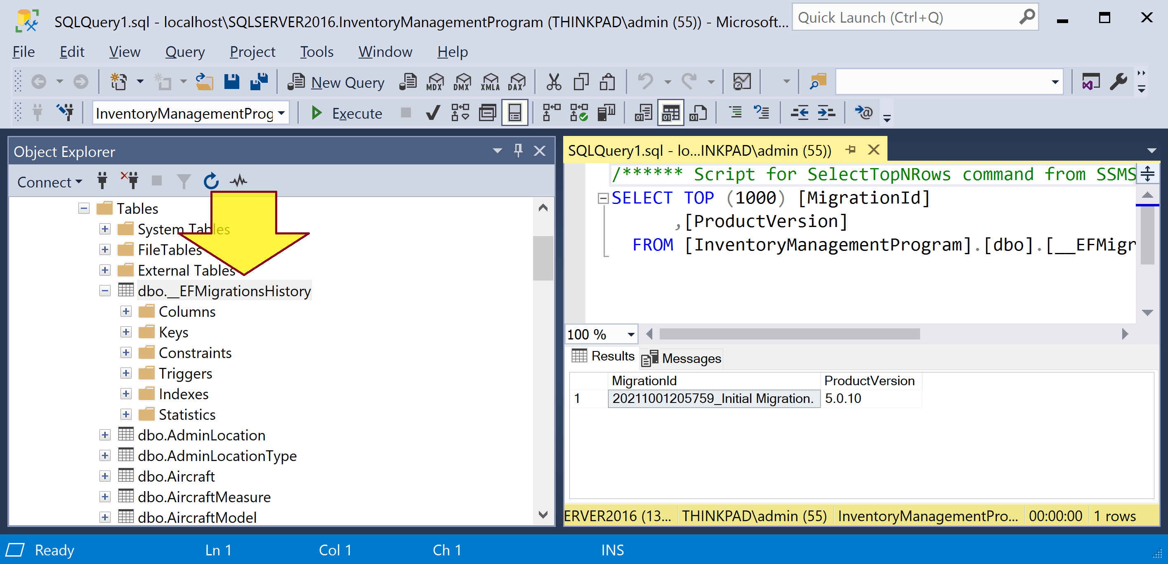
Examine the Database

Slide 12
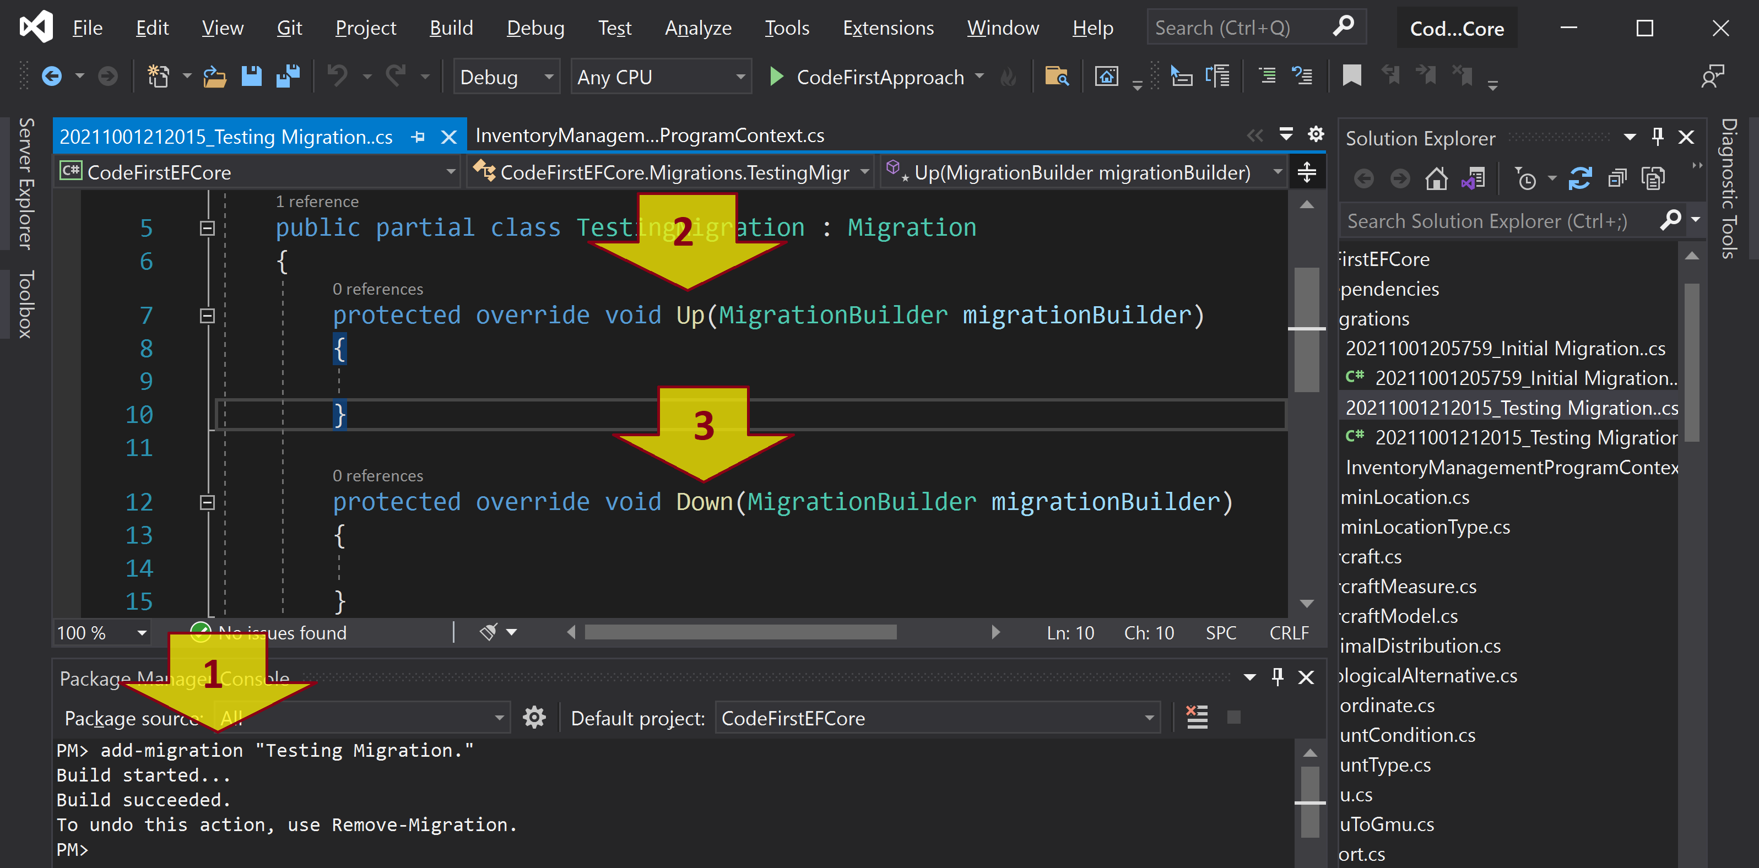
Add another Migration
add-migration "Testing Migration."

Slide 13
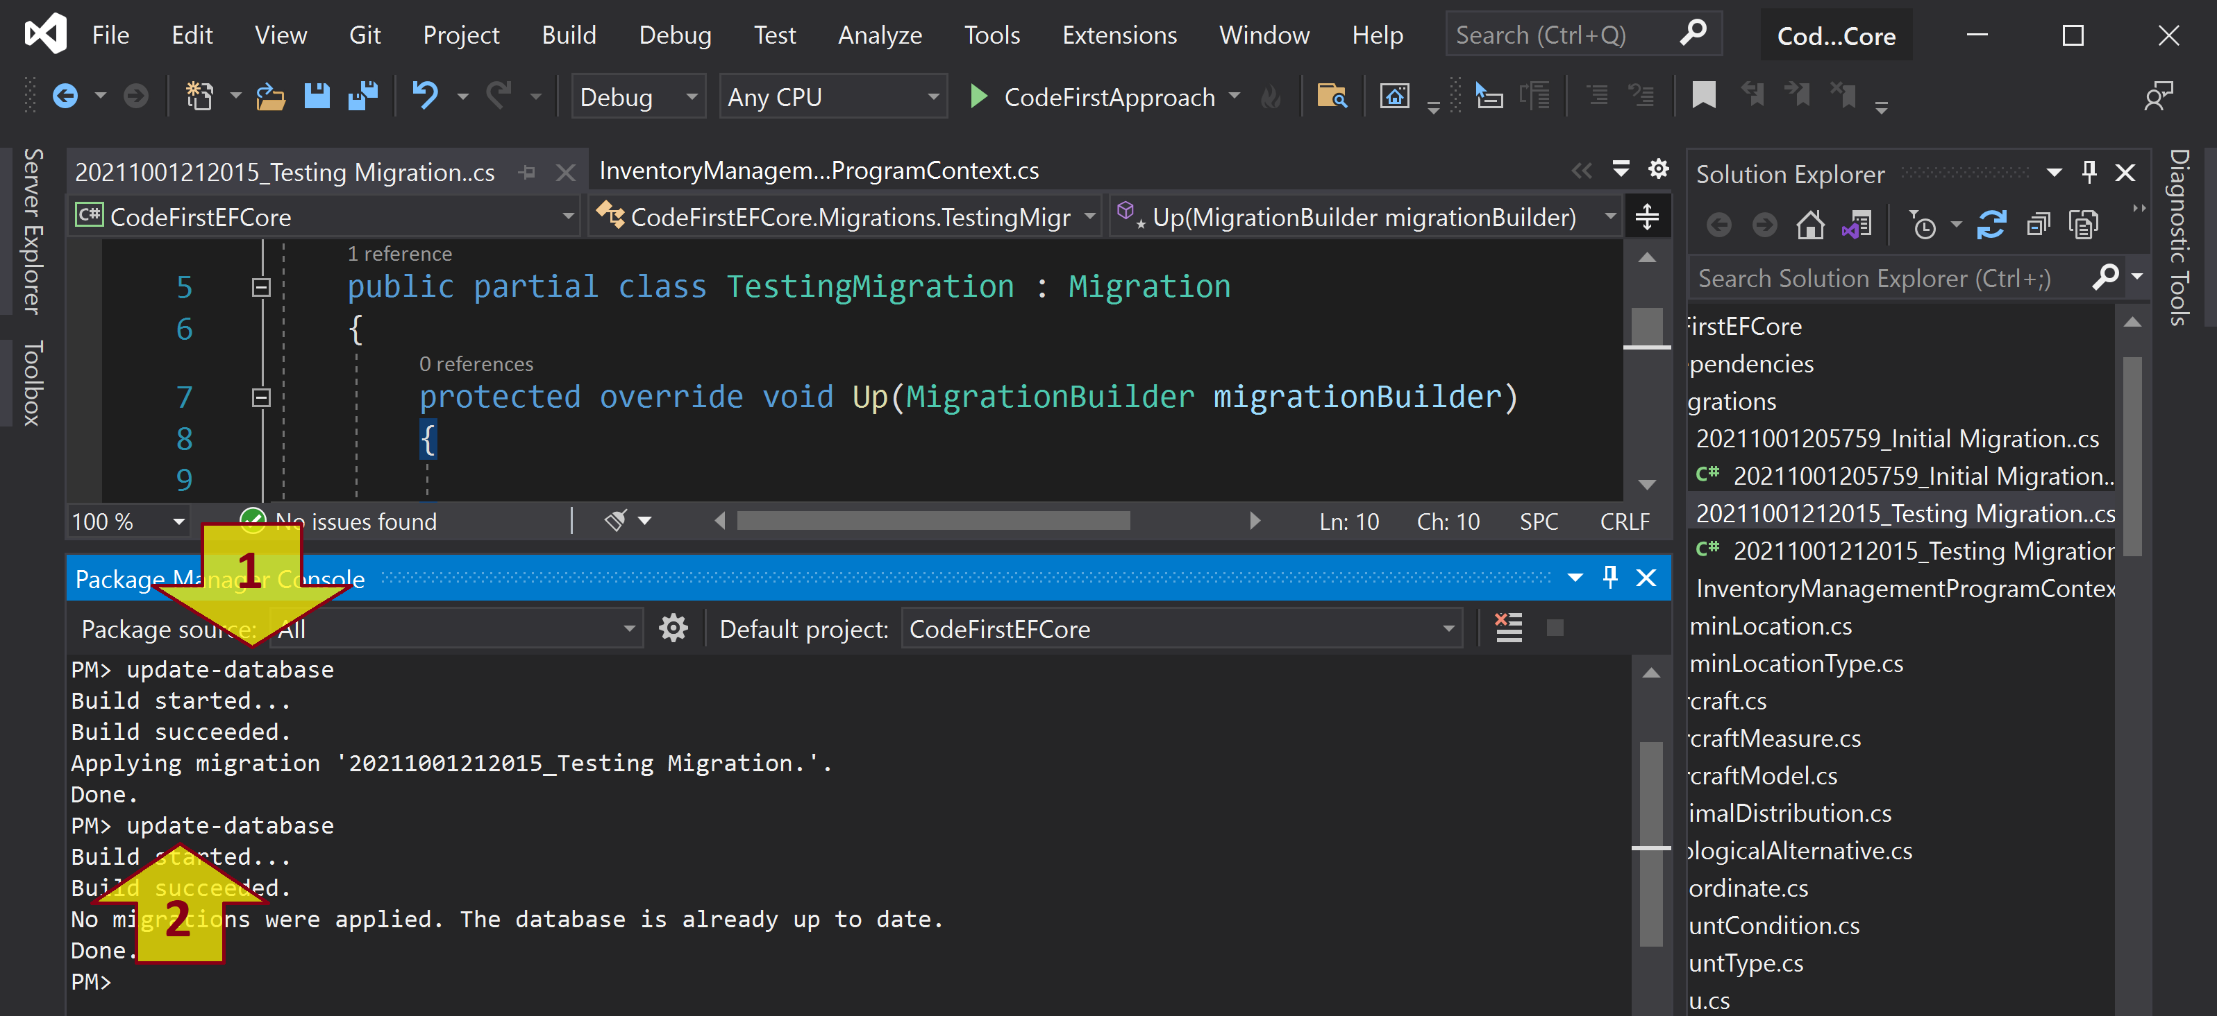
Run update-database Twice
update-database
update-database

Slide 14
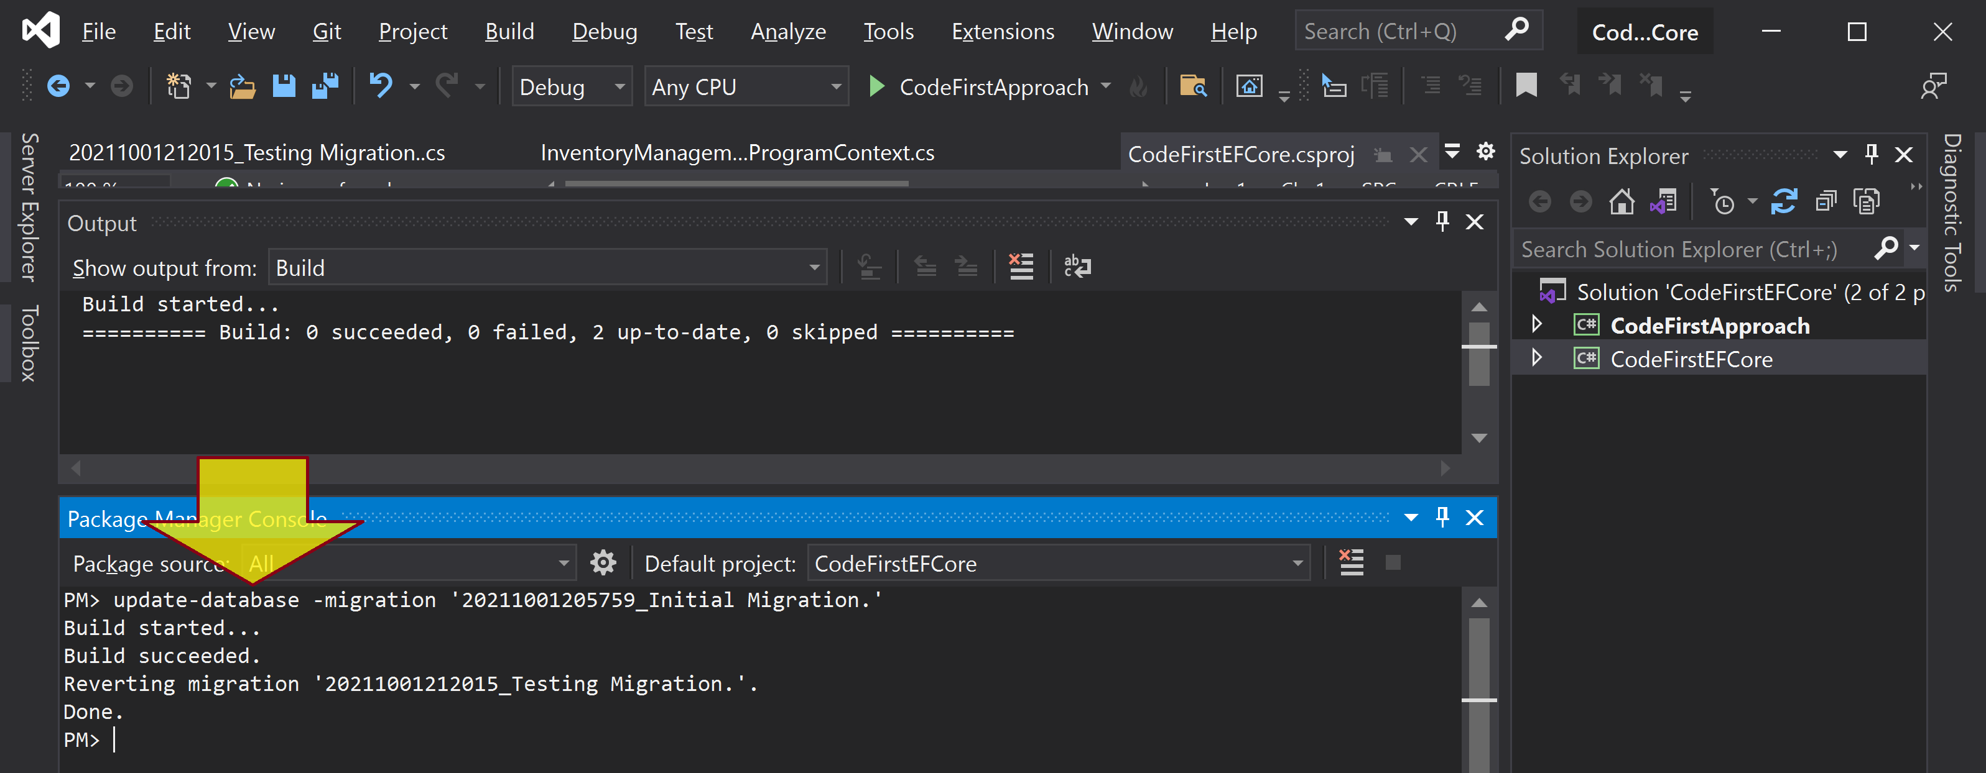
Revert to a Migration
update-database -migration '20211001205759_Initial Migration.'

Slide 15
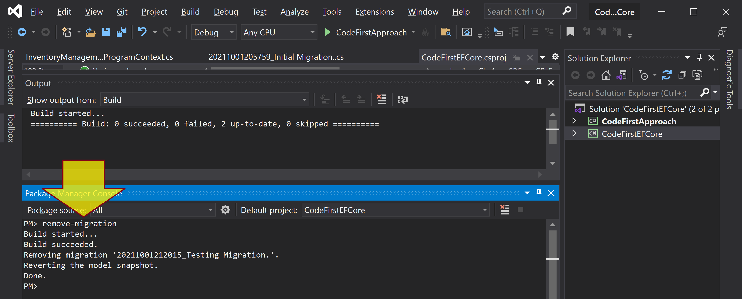
Remove a Migration
remove-migration

Slide 16

Thank You & See You Again

